Slide 1
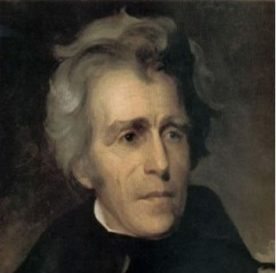
The Age of Jackson
Name
Date
Class Period

Slide 2
The Age of Jackson Overview
Overview
Project Guidelines
The "Age of Jackson" is the term used to frame Jackson's administration from 1829 to 1837, and from 1837 to 1849, during which the Jacksonian Democrats held power.
During these years, democracy began to expand:
as states rewrote their constitutions
and extended the right to vote to all free white males.
Although inequalities existed, by the late 1830s, the United States had become a full democracy for adult white males.
Jackson was a symbol of the new age of democracy, the "age of the common man."
Jackson, who enjoyed wide support among Americans, was the first leader of the modern Democratic Party.
Complete the activities on each slide.
You will have to erase the questions to complete the answers.
If it is a question use the question in the answer in full complete sentences.
See the rubric for how you will be graded.

Slide 3
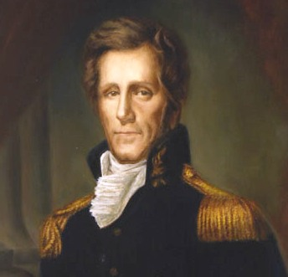
Who was Andrew Jackson? (Page 349)
5-6 Bullets on his life and military career.

Slide 4
The Election of 1824 (Page 350)
What happened during the election of 1824?
Why did Jackson’s supporters claim there had been a “corrupt bargain”?

Slide 5
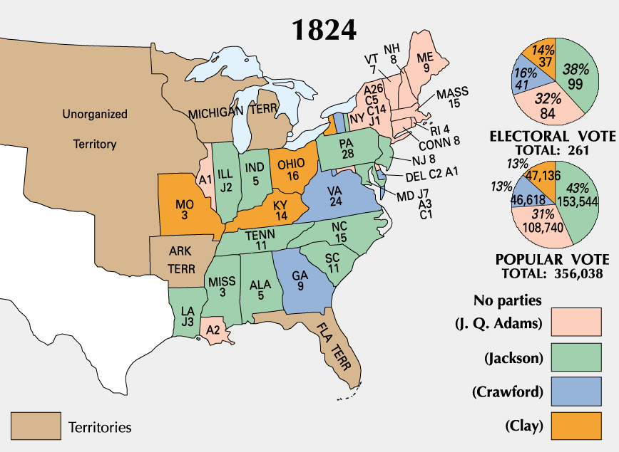
Election of 1824
Summarize pie chart in 2-3 sentences.

Slide 6
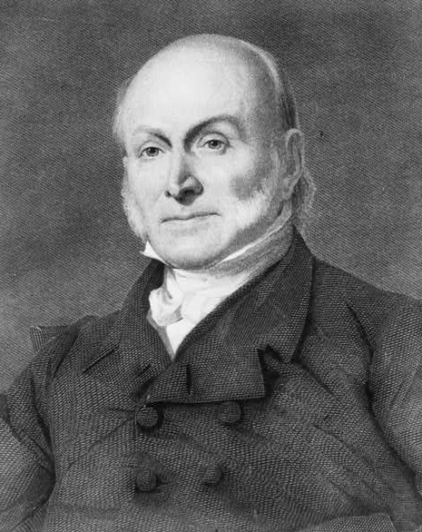
The Presidency of John Quincy Adams (350-351)
Summarize the one term presidency of John Quincy Adams in 3 bullets.
Why did he never win the trust of the American people?
John Quincy Adams

Slide 7
Democracy in the Age of Jackson (352)
What did supporters of Andrew Jackson believe?
What did his supporters oppose?
What did they not trust and why?

Slide 8
New Political Parties (352)
4-5 bullets--Details on the two new political parties and how did the process for political parties to pick a presidential candidate change?

Slide 9
Jackson Becomes President (353)
Explain the election of 1828 and Jackson’s Inauguration in 4-5 bullets.

Slide 10
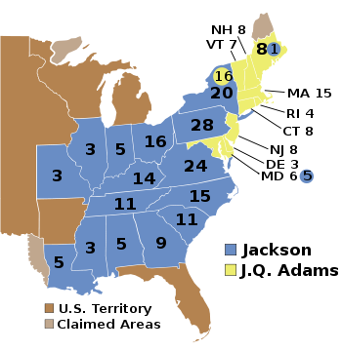
Election of 1828
Explain the election of 1828 map in 2-3 sentences.

Slide 11
The Spoils of Victory (354)
Define spoils system.
How did it apply to Andrew Jackson?

Slide 12
Jackson was criticized for the practice of the spoils system.
But his answer was that he was merely filling the government with common people and wasn’t that the true definition of democracy?
Do you agree?? Yes or no and why?

Slide 13
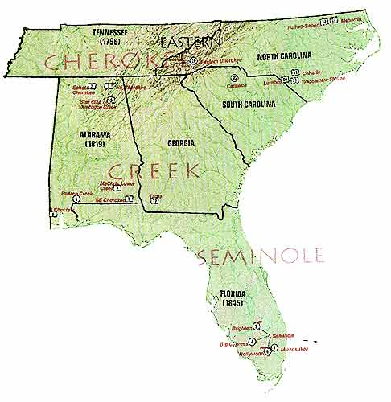
Native American Removal (355)
What were some of the customs and ways of life of the Cherokees?

Slide 14
Conflict Over Land (357)
In 5-6 bullets describe the conflict over land with the U.S. government and Native Americans.

Slide 15
Support for Native Americans (357)
What is the significance of the court case Worcester v. Georgia in 1832 and what was Jackson’s response to it?

Slide 16
Trail of Tears (358)
2-3 bullet description of the Trail of Tears.
What mistakes in planning did the government make before removing Native Americans?

Slide 17
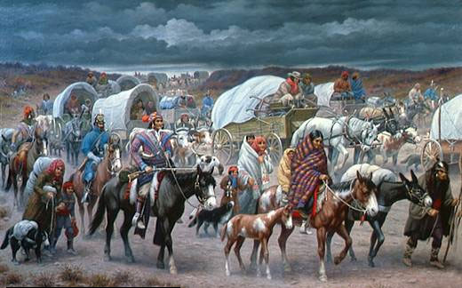
Trail of Tears
Extra credit—What can you find out about this painting? When was it painted? By who? Significance?

Slide 18
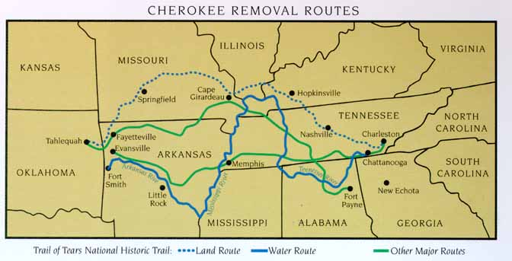

Slide 19
The Bank War (362-363)
Why did Andrew Jackson hate the National Bank?
What were the arguments for and against the second bank of the United States?
What did Jackson’s victory over the Bank help increase and why?

Slide 20
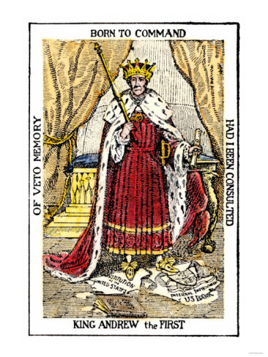
King Andrew the First
Name two negative images in the cartoon. Why do you think Jackson is shown stepping on the bank document?
Would this cartoon have the same impact in Britain if, instead of Jackson, it showed a British leader? Explain your answer.

Slide 21
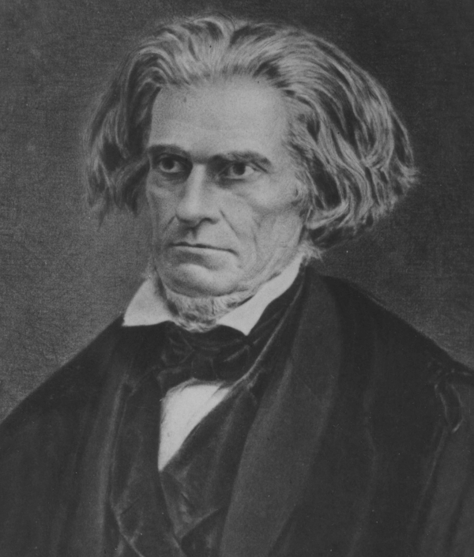
The Nullification Crisis (364-365)
Why did the crisis erupt?
Define nullification.
What did Vice President John C. Calhoun argue?
Vice President
John C. Calhoun

Slide 22
The Nullification Crisis (354-365)
Arguments for Nullification
Arguments Against Nullification

Slide 23
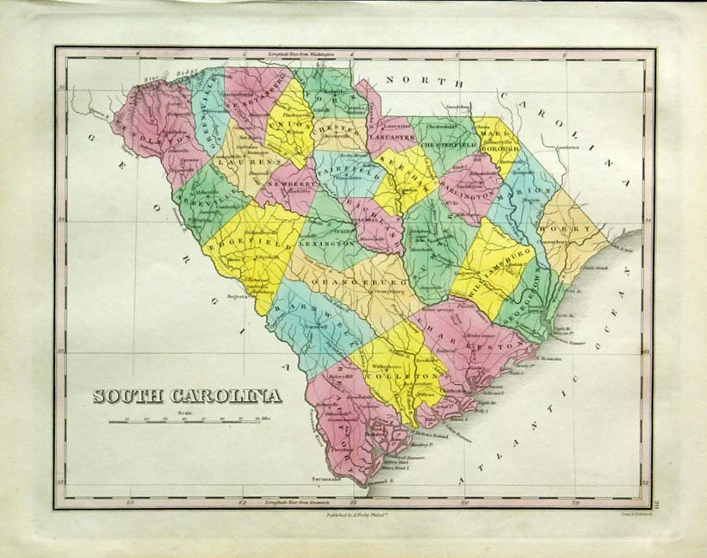
South Carolina Threatens to Secede (364-366)
Why does South Carolina threaten to secede or leave the Union?
How did Andrew Jackson respond to this threat?
How did South Carolina respond to Jackson’s actions?

Slide 24
The End of the Jackson Era (366-377)
Who was Andrew Jackson’s choice to succeed him as president and why?
Who won the election of 1836?
What were the two main causes of the Panic of 1837 and what was the result?
What ended the Age of Jackson?

Slide 25
Closure Presentation Questions…
You will need to present your finding from your research to the class by answering the questions on the following two slides.
You will present only the following slides not your entire Power Point.
These questions are opinioned based, but you must use information you have researched on your previous slides.
You may include photos you have found on-line or create charts or diagrams to illustrate your points.
You may format the slides however you like. Make sure the audience can understand and read the slides.

Slide 26
Did Jackson help or harm the American People?
He made THREE major decisions
Removal of Native Americans
Nullification Crisis
Bank of the United States
You will need to make a determination concerning the above question using evidence from these three decisions in 4-5 sentences.

Slide 27
Do you agree or disagree that President Jackson was the “people’s president”. Was he a good president? Please provide evidence in your response. Must be at least 5-6 sentences with one visual when you present.

